Slide 1
DSC640 Project task 2
Edris Safari

Slide 2
Do Airline Crashes & Fatalities affect Travelers?
What are the Facts?
What are the myths?
What is the solution?

Slide 3
FACTS
Number of fatalities have declined over the years
Number of incidents have declined over the years
Number of travelers have increased

Slide 4
MYTHS
Too many fatal crashes
Too many incidents
Traveling is not safe

Slide 5
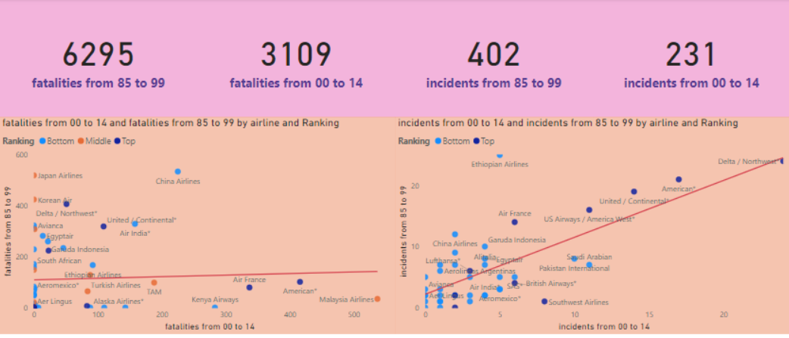
Data Shows…
Declines in fatalities AND incidents
Fatalities are UNpredictable incidents are predictable

Slide 6
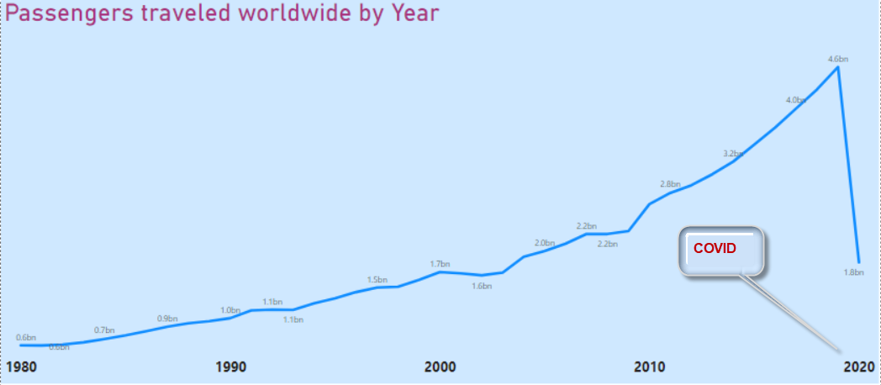
Data Shows…
Passenger travel shows increase over time.

Slide 7
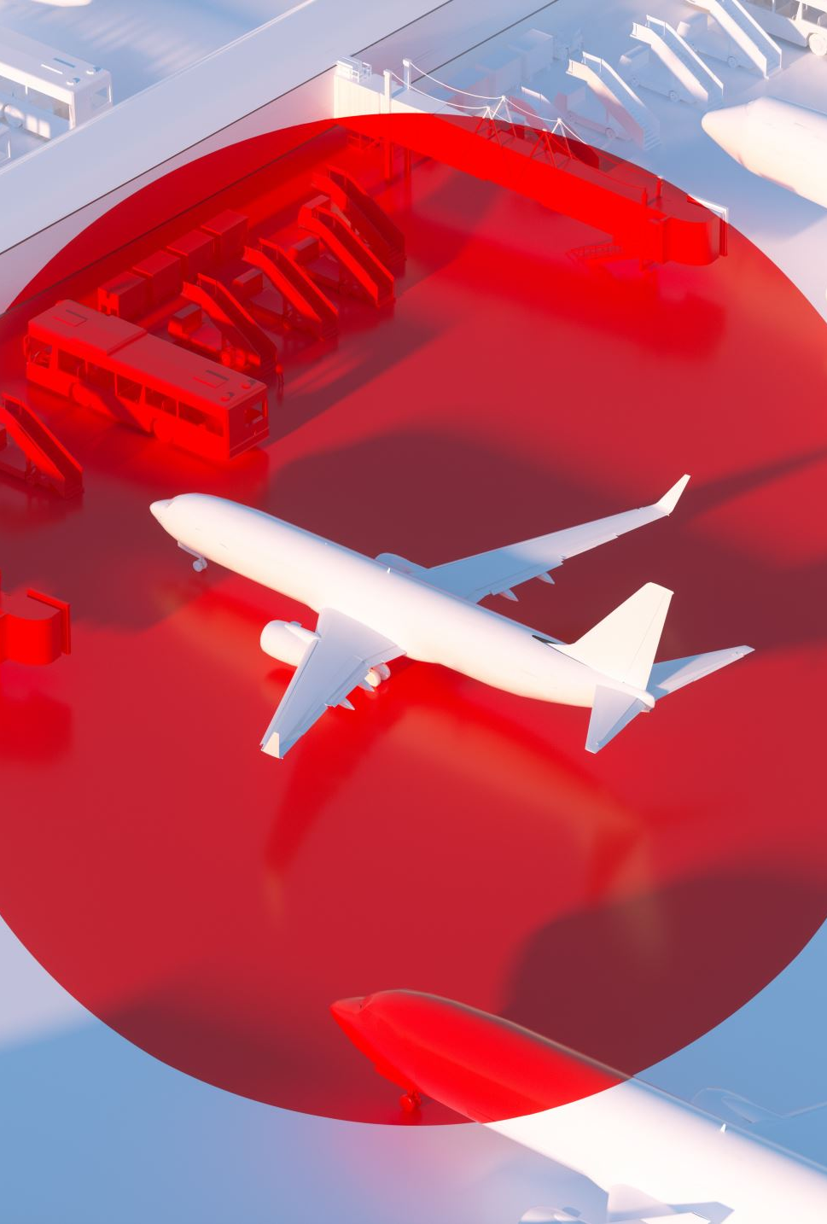
Solution
Decrease Incidents
Publicize Air Travel

Slide 8
SOURCES OF DATA
Aviation Safety Network, Flight Safety Foundation
WorldBank Data:
https://data.worldbank.org/indicator/IS.AIR.PSGR?end=2020&start=1970&view=chart

